Slide 1

Easy Finance – Process Definitions
Digitalization China
August 2018

Slide 2
EF-EP-009
EPIC:
Application handling (Application Form / co-borrower etc.)

Slide 3
EF-EP-009: Application handling (Application Form / co-borrower etc.)
Story ID: EP009-S 001:
As a user, I want to fill the personal information as guide step by step, after passed PBOC check, so that fill the application form online.
Story ID: EP009-S 002:
As a user, I want to add Co-borrower/Guarantor role and fill their personal information to help me get approval, so that i can get my application approved
Story ID: EP009-S 003:
As a user, I want to add Co-borrower/Guarantor role, after my application is send back from GCAP, so that get loan approval.
Story ID: EP009-S 004:
As a user, I want to be notified about the application status, so that I can proceed with the process.
Story ID: EP009-S 005:
As a user, I want to be notified if I selected marital status as "married", that i have the option/ recommendation to add Co-borrower, so that add Co-borrower/Guarantor proactively.

Slide 4
EF-EP-009: application handling
Story ID: EP009-S007-SZ:
As an existing customer and eApp user, I want to have my existing information pre-filled, so that I can avoid duplicated efforts.
Story ID: EP009-S008-SZ:
As an existing customer and eApp user, I want to edit my pre-filled information, so that I can update my personal information.

Slide 5
Story ID: EP009-S001-Alex Wang:
Business
As a user, I want to fill the personal information as guide step by step, so that fill the application form online.
Assumptions:
Pre-Conditions:
Before Pre-check process
After passed E-authentication process
eAPP integrated with DFE for application information input.
Acceptance Criteria:
Before personal information filled, the page for selecting customer role (Borrower, Co-borrower, Guarantor 1, Guarantor 2) is needed, and each applicant (role) have their own personal information page to fill.
No matter personal information of existing role is completed or not, add/delete other role is acceptable.
Default role is Borrower, other roles need to be added manually and go through the E-authentication process.
Some personal information is able to be auto-filled from E-authentication step, i.e. ID type, ID #, Name …, and also these information is disable to be modified unless go through again the E-authentication process.
Information field should distinguish mandatory field and optional field.
In consider of data accuracy, Verify information is valid or not. Different information type is correlative to different data format, i.e. Name filed -> Chinese or English character; phone No. - > maximum 11 Number characters; date -> calendar selected; Age or living period should be auto calculate;
There is indicator to show applicant how percentage of information has been filled. Percentage only count the mandatory’s fields.
If the mandatory information is not completed yet, it would not go to next step → Pre-check process.
Update status as ‘application information drafted’ in eAPP.
All filled information should be auto saved.
At least have 1 office address in one application.
Emergency contact person is needed when NOT fixed-line information.
Pre-check button will be available once all information for each role is 100% filled.
All information should be sync to DFE accordingly once click ‘Submit Pre-check’ button
If fix-hotline is not provided, at least one emergency contact information is needed.
IT

Slide 6
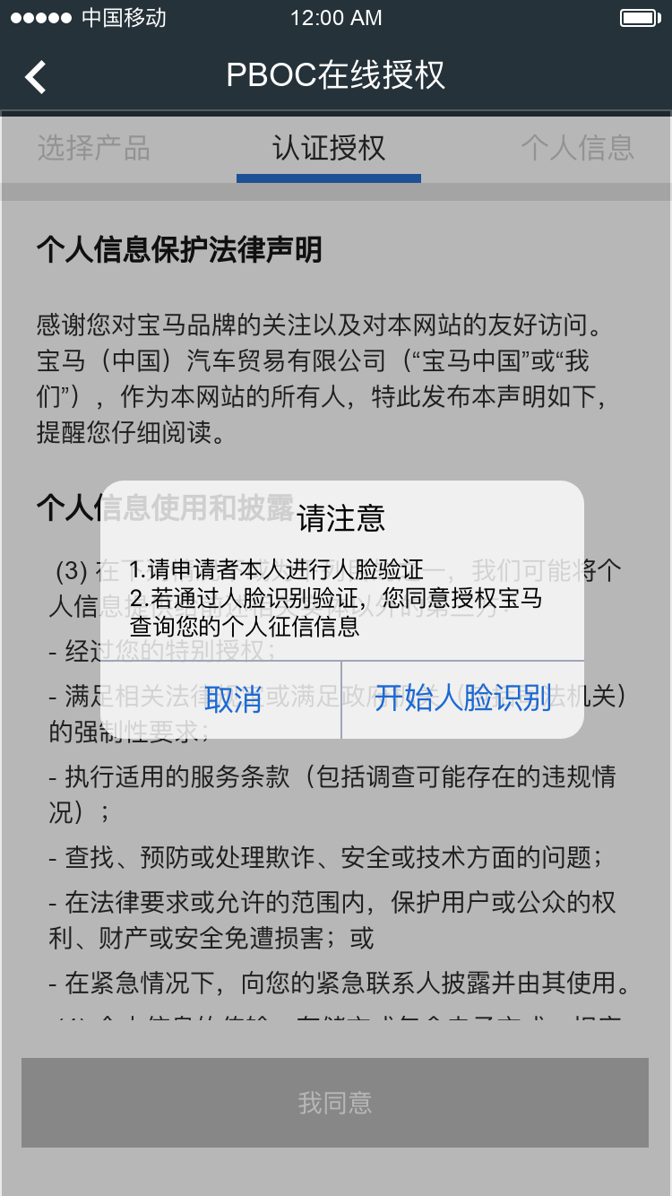

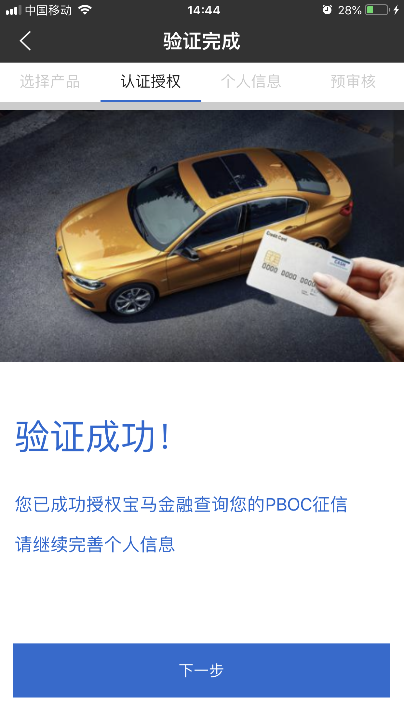


Story ID: EP009-S001- Alex Wang:
Wireframes:
Personal info
Personal info
Borrower: Name
0%
Borrower: Name
50%
Face recognition:
1. Photo Comparison
(with ID Card Photo)
2. Vivo detection
PBOC authorization process in E-Authenticaiton
Add Co-borrower
Add Guarantor 1
Add Guarantor 2
Pre-check
Personal info
Borrower: Name
0%
Pre-check

Slide 7
Story ID: EP009-S001-Alex Wang:
Mockups:
1. 您提供的银行账单是否显示了雇主支付给您的月工资？
2. 您的公司是否在工商局正式注册的？
3. 是否在公司验资报告或工商局注册网上能显示您的持股？
back
Next
Logic
Customer type confirm
SME
Yes
Question 3
Y/N
No
Yes
Retired/Student/Unemployed
Question 2
Y/N
No
No
Y/N
Question 1
Free Lance
Yes
Employee
Notes:
BMW INTERNAL ASSOCIATE

Slide 8
Story ID: EP009-S001-Alex Wang:
Mockups:
back
您是否就职于500强
是否高首付，系统判断
是否留存客户，系统判断
是否本地经营满两年
是否本地户籍，系统判断
是否符合限牌城市政策
是否符合连续缴纳公积金
Personal info
back
Next
back
Next
back
Next
Next
back
Finish
Personal Info
Contact Info
Employment Info
Affordability Info
Property confirm
Borrower: Name
100%
Customer type selected*:
Borrower
Mobile 1*
Mobile 2
Industry
Sub-industry
# of Children
Y/N
Chinese Name*
Gender*
Male
Family Tel.
Office Tel
Occupation
Job title
Monthly income
Nationality selected*:
China
Address Type*
Home
Company Name
Quarterly Interest Earned
?
Province*
City*
Y/N
ID Type*
PRC ID
ID #*
110110
Address details*
Zip code
Employed Since
2017/07/28
Employed Month
Auto-calculation
Monthly rent
ID valid date*
2017/07/28
Age
Click “?” to show what is quarterly interest earned, explanation such like: around 3/21, 6/21, 9/21, 12/21, bank will pay you an quarterly interest, please fill this amt of nearest date here
Y/N
Ownership*
Living start date*
Shareholding %
Marital Status*
Unmarried
Duration in Month
Registered capital
Y/N
Hukou-Province*
Is it a Mailing address
√
Add
# of employee
Does any Applicant own a property
Y/N
Hukou-City*
Office address
Which is your property above:
H/O/None
E-mail
@
Add
Education Level*
Postgraduate
Who is the owner of property
B/CB/G
Emergency Name
?
Relationship
Is it a village Property
Y/N
Pre-check
Emergency Tel.
Click “?” to show what condition need to add emergency person, explanation such like: Waive Co-borrower, or fix line telephone no provide
Prefilled information from E-authentication
Optional information
Emergency Name
?
Relationship
Emergency Tel.

Slide 9
Story ID: EP009-S001-Alex Wang:
Wireframes:
Personal info
back
Next
back
Next
Personal info
1. 您提供的银行账单是否显示了雇主支付给您的月工资？
2. 您的公司是否在工商局正式注册的？
3. 是否在公司验资报告或工商局注册网上能显示您的持股？
Customer type confirm
Personal Info
Borrower: Name
0%
Borrower: Name
100%
Y/N
Customer type selected*:
Borrower
Chinese Name*
Gender*
Male
Y/N
Nationality selected*:
China
ID Type*
ID #*
110110
…
PRC ID
Y/N
ID valid date*
2017/07/28
Age
Marital Status*
Unmarried
Hukou-Province*
Hukou-City*
E-mail
@
Education Level*
Postgraduate
Emergency Name
?
Relationship
Pre-check
Emergency Tel.
Personal info
Personal info
1. 您提供的银行账单是否显示了雇主支付给您的月工资？
2. 您的公司是否在工商局正式注册的？
3. 是否在公司验资报告或工商局注册网上能显示您的持股？
Personal info
back
Next
back
Next
Customer type confirm
Borrower: Name
100%
Borrower: Name
50%
Personal Info
Borrower: Name
100%
Y/N
Customer type selected*:
Borrower
Chinese Name*
Gender*
Male
Nationality selected*:
China
Co-Borrower: Name
100%
Y/N
ID Type*
PRC ID
ID #*
110110
Y/N
ID valid date*
2017/07/28
Age
Marital Status*
Unmarried
Hukou-Province*
Hukou-City*
Add Co-borrower
Add Guarantor 1
Add Guarantor 2
E-mail
@
Education Level*
Postgraduate
Emergency Name
Pre-check
?
Relationship
Pre-check
Emergency Tel.
Personal info
Borrower: Name
100%
Co-Borrower: Name
50%
Pre-check

Slide 10
Story ID: EP009-S002-Owen:
Business
As a user, I want to add Co-borrower/Guarantor role and fill their personal information to help me get approval, so that add Co-borrower/Guarantor proactively.
Assumptions:
Pre-Conditions:
Each role who new added also need to finish E-authentication but before pre-check step
eAPP integrated with DFE for application information input.
Acceptance Criteria:
There is one page in eAPP to allow applicant to add other application role(co-borrower/guarantor) and fill the personal info. of all these roles.
There is one button + by clicking this button, customer can select one role to add into current application. When adding one role, first system will triger e-authentication process, only if the e-authentication passed, when the role can be added successfully.
Accordingly, there shall be one record to let the specific person fulfill the personal info. by default this record is archieved by role, if user click this record, then detailed fields can be shown to customer.
There are maximum 3 roles (Co-Borrower, Guarantor 1, Guarantor 2) could be added in one application besides of borrower.
The personal information fields of each role is the same(detail fields refer to user story EP009-S001 )
The role and relevant personal information can be edited and deleted at any time before submission
Guarantor is mandatory to add when main-borrower’s age is <26 and finance amount > 300,000.(this rule shares the same configuration with DFE)
When borrower fulfill the personal information, if marital status is selected as "married“, then system will pop up an recommendation message to remind borrower to add co-borrower. Borrower can choose yes/no. if yes, system can automatically add one role of co-borrower. if no, borrower can also manually add co-borrower.
The personal info. of co-borrower and guarantor can be find in DFE once the info. are saved in E-App; and if the info. is fulfilled in DFE, then these info. can also be find in E-App

Slide 11
Story ID: EP009-S003-Owen:
Business
As a user, I want to add Co-borrower/Guarantor role, after my application is send back from GCAP, so that get loan approval.
Assumptions:
ASSUMPTION A
ASSUMPTION B
ASSUMPTION C
Pre-Conditions:
The role who new added have no finish pre-check.
Application has been got decision by CA team.
Applicants can receive the message on eApp.
eAPP integrated with DFE for application information input.
Acceptance Criteria:
When application is send back by back office, user can edit or delete the exsiting role and relevant personal information.
When application is send back by back office, user can add role and add the personal information of the new added role.
Other business rules are the same with EP009-S002, please refer to EP009-S002.

Slide 12
Story ID: EP009-S002 & S003 - Alex Wang:
Mockups:
Personal info
E-authentication
For Co-Borrower
Personal info
Personal info
Borrower: Name
50%
Borrower: Name
50%
Borrower: Name
0%
Add Co-borrower
Add Guarantor 1
Add Guarantor 2
Co-Borrower: Name
0%
Co-Borrower: Name
Delete
Follow the E-authentication
process and get pass

Slide 13
Story ID: EP009-S005-Alex Wang:
Business
As a user, I want to be notified if I selected marital status as "married", then I can get a reminder to add Co-borrower, so that add Co-borrower proactively.
Assumptions:
ASSUMPTION A
ASSUMPTION B
ASSUMPTION C
Pre-Conditions:
Before Pre-check process
Acceptance Criteria:
When main borrower’s marital status selected as “married”, eApp will pop-up to suggest applicant to add Co-borrower once he/she back to selecting role page.
If click “yes”, then if exit the page back to role page, start E-authentication for Co-borrower. (follow EP007 – S002), the vehicle information and SF product is unchanged.
IT

Slide 14
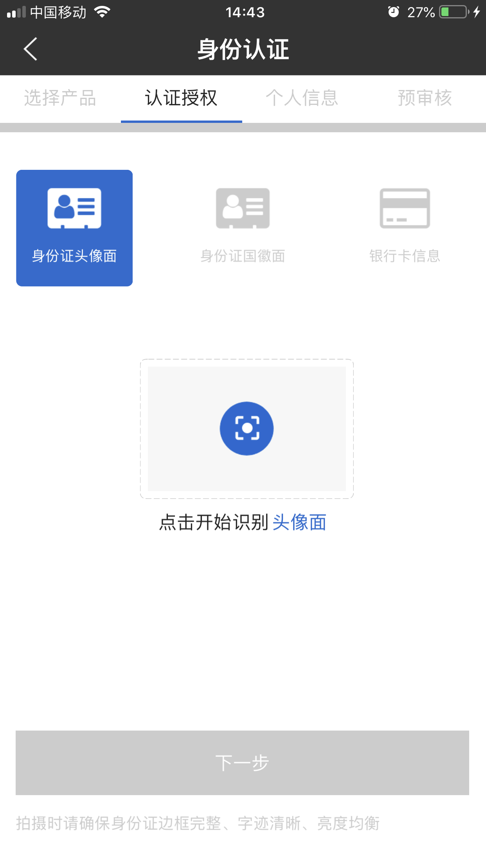
Story ID: EP009-S005- Alex Wang:
Mockup and Wireframes:
back
Next
Personal info
Personal Info
Borrower: Name
100%
Customer type selected*:
Borrower
Chinese Name*
Gender*
Male
Would you like to add your spouse as Co-borrower?
Nationality selected*:
China
ID Type*
PRC ID
ID #*
110110
ID valid date*
2017/07/28
Age
Marital Status*
Married
Yes
No
Hukou-Province*
Hukou-City*
E-mail
@
Education Level*
Postgraduate
Emergency Name
?
Relationship
Emergency Tel.

Slide 15
Story ID: EP009-S007-SZ:
Business
As an existing customer and eApp user, I want to have my existing information pre-filled, so that I can avoid duplicated efforts.
Assumptions:
Interdependencies with EP009-S001, S002, S003, S005
Pre-Conditions:
User has passed Pre-check.
DFE will sync data with eApp.
Acceptance Criteria:
The App will run an auto-check whether the user is an existing customer (existing AFC borrower/co-borrower/guarantor) based on ID number stored in DFE.
If the user is an existing customer, a pop-up window and a button will appear to notify the user “We have identified you as an existing customer, please review existing information and update if necessary.”
Customer’s existing information in DFE will be pre-filled in eApp.
If the user is not an existing customer, process follows new users for application handling (EP009-S001, S002, S003, S005).
IT

Slide 16
Story ID: EP009-S008-SZ:
Business
As an existing customer and eApp user, I want to edit my pre-filled information, so that I can update my personal information.
Assumptions:
Interdependencies with EP009-S001, S002, S003, S005
Pre-Conditions:
User has passed Pre-check.
User accepted to pre fill info from Existing Customer data.
DFE will sync data with eApp.
Acceptance Criteria:
Once all information is confirmed, just click “Continue” to proceed with the Application Handling process.
IT
Notes:
Remove edit

Slide 17
Story ID: EP009-S007 & S008-sz:
Process Flow:
APP
Pop up window to notify customer and to confirm existing information
APP
Existing information will be pre-filled from DFE
User
Review existing information & edit if needed
User
Confirm all information & proceed to next step
Easy Finance APP
Retention Customer Application Process
DFE
Auto-check if existing customer based on ID #
Pass Customer
National ID
If existing customer
Respond
Existing Customer Data
If not existing customer
APP
Follow the same application process as new customers

Slide 18
Story ID: EP009-S007 & S008-sz:
Mockups:
For existing customers
back
back
back
back
Application Form
Application Form
Pre-Check Result
Pre-Check Result
Stella Zhang
Stella Zhang
Pass
We have identified you as an existing customer, please review existing information and update if necessary
Pass
110123456789123456
110123456789123456
01/01/1980
Refer to EP010-S007-SZ for next step
01/01/1980
。。。
。。。
OK
Gateway 22B, Chaoyang
Gateway 22B, Chaoyang
Accept
Accept
Cancel
Continue
Edit
Confirm

Slide 19
Story ID: EP009-S007 & S008-sz:
For non-existing customers or
non-Green Channel customers
Mockups:
For non-existing customers
back
back
Docs upload
Application Form
Pre-Check Result
Name
Pass
ID #
Bank Statement
?
Property docs
?
DOB
Refer to EP010-S007-SZ for next step
。。。
Others
?
Address
Accept
Cancel
Continue
Mandatory
Optional

